Slide 1
CMST 315: Design Challenge
Bryan, Gannon, Matthew, Morgan

Slide 2
Constraints:
ISP address: 206.12.0.0/17 (11001110.00001100.00000000.00000000)

Slide 3
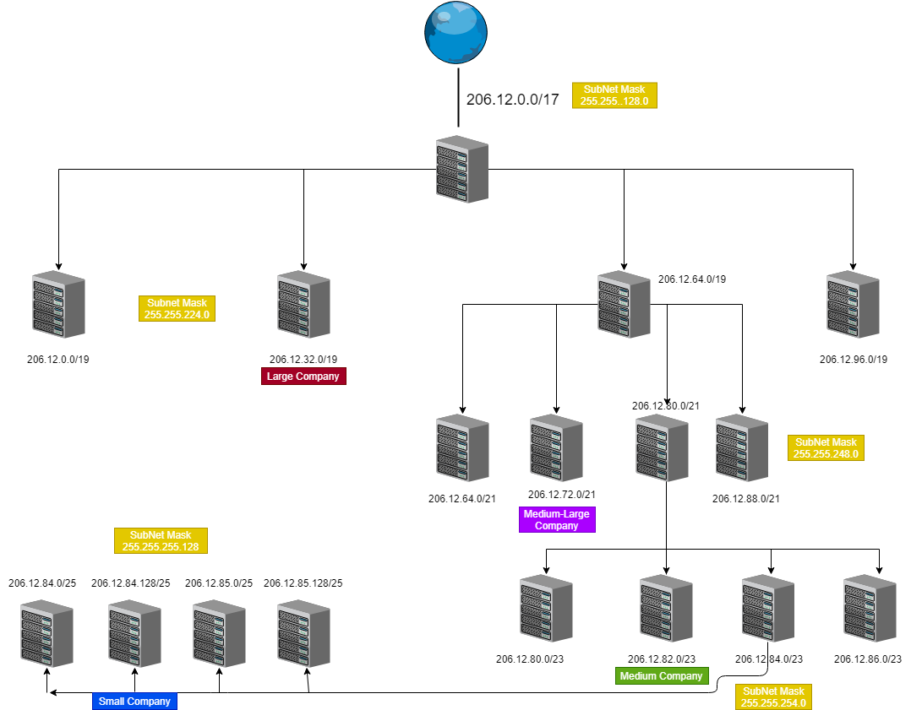

Slide 4
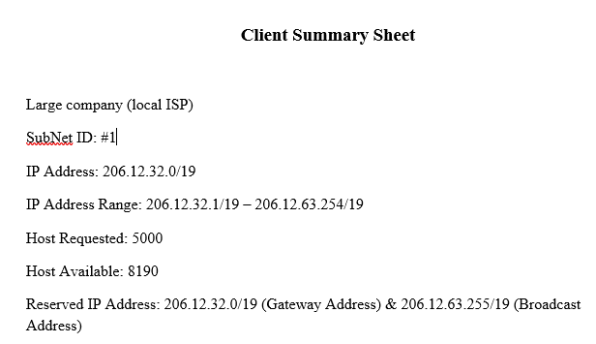
Summary Sheet #1: Large Company

Slide 5
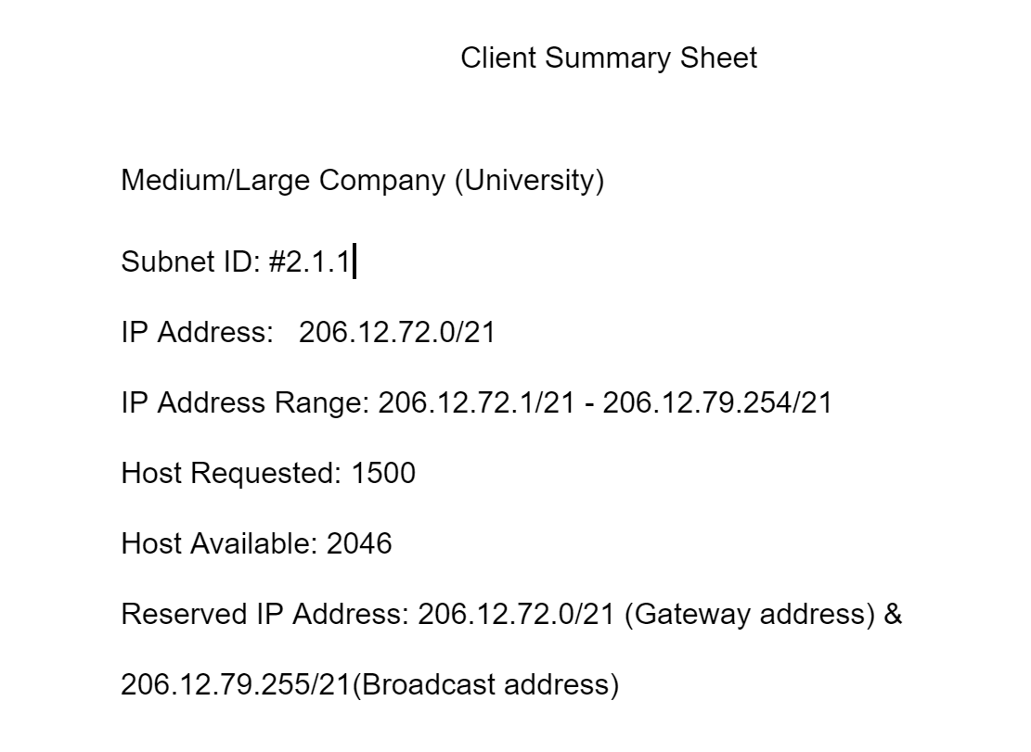
Summary Sheet #2 : Medium-Large Company

Slide 6
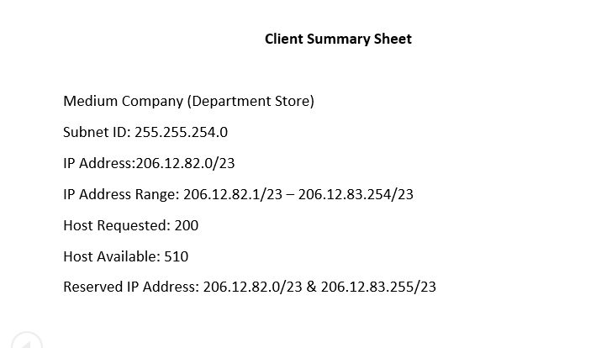
Summary Sheet #3: Medium Company

Slide 7
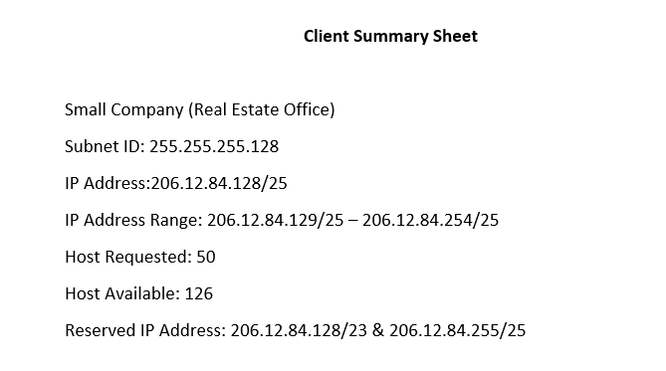
Summary Sheet #4: Small Company

